Slide 1

AI BASED –LOAN ELIGIBILITY PREDICTIN
Team-21

Slide 2
TABLE OF CONTENTS
01
04
02
05
03
OUR TEAM
LEARNING MODEL
Details about our team mates.
Information about the learning model we used.
INTRODUCTION
CONCLUSION
Introduction about the functionality of the system.
Overall conclusion on the project.
ABOUT DATA SET
Information about the dataset and attributes.

Slide 3
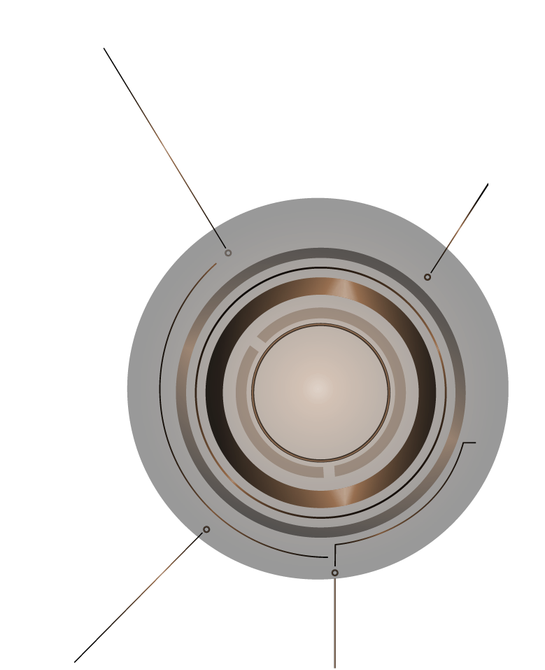
TEAM
1
2103A51248 - T.ABHILASH RAO
2103A51313 - D.HRITHVIK REDDY
2103A51054 - L.SRIVARDHAN RAO

Slide 4

INTRODUCTION
02

Slide 5

INTRODUCTION
Loan Prediction is very helpful for employee of banks as well as for the applicant also. The aim is to provide quick, immediate and easy way to choose the deserving applicants. It can provide special advantages to the bank. The Loan Prediction System can automatically calculate the weight of each features taking part in loan processing and on new test data same features are processed with respect to their associated weight .A time limit can be set for the applicant to check whether his/her loan can be sanctioned or not. Loan Prediction System allows jumping to specific application so that it can be check on priority basis.

Slide 6
whole process of prediction is done privately no stakeholders would be able to alter the processing. Result against particular Loan Id can be send to various department of banks so that they can take appropriate action on application. This helps all others department to carried out other formalities.

Slide 7

About Data Set
03

Slide 8

ABOUT DATA SET
->Our data set contains 1228 rows and 13 columns and 12 attributes.
The company wants to automate the loan eligibility process (real-time) based on customer detail provided while filling the online application form. These details are Gender, Marital Status, Education, Number of Dependents, Income, Loan Amount, Credit History, and others. To automate this process, they have given a problem to identify the customer's segments, those are eligible for loan amount so that they can specifically target these customers. Here they have provided a partial data set.

Slide 9
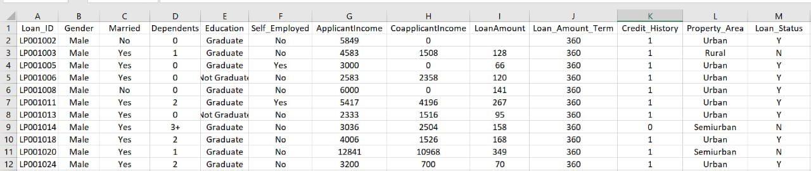
DATA SET

Slide 10
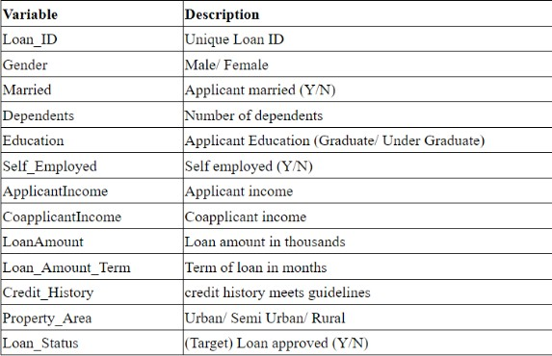
Attributes -

Slide 11

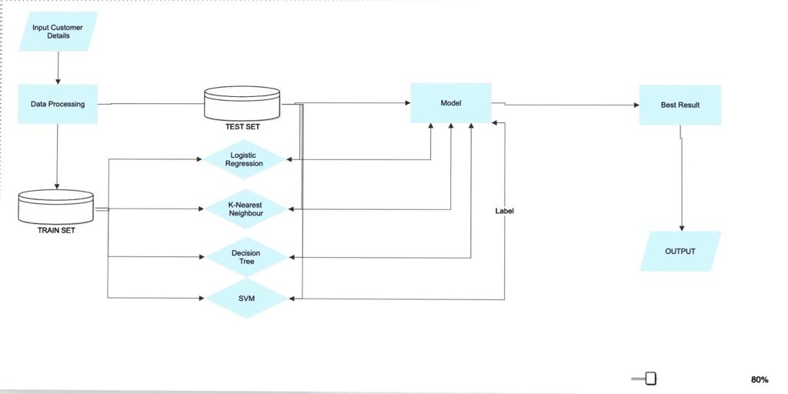
FLOW CHAT

Slide 12
04
Learning model

Slide 13
SUPERVISED LEARNING
Supervised learning is a type of machine learning where a model is trained on labeled data. In supervised learning, the input data is paired with the corresponding output data or labels, and the model learns to predict the output based on the input data.
The goal of supervised learning is to build a model that can make accurate predictions on new, unseen data. To achieve this, the labeled data is split into training data and testing data. The model is trained on the training data, and its performance is evaluated on the testing data.

Slide 14
Algorithms used
logistic regreation
svm
decision tree
knn
Naive bayes

Slide 15

Advantages
Speed and accuracy: AIML models can quickly process and analyze large amounts of data to predict loan eligibility with high accuracy.
Consistency: AIML models can be designed to follow consistent decision-making criteria, which reduces the potential for human error or bias.
Increased access to credit: By accurately predicting loan eligibility, AIML models can expand access to credit for borrowers who may have been overlooked by traditional lending institutions.
Cost-effective: Using AIML models for loan eligibility prediction can reduce costs associated with manual underwriting processes.

Slide 16
Disadvantages
Over-reliance on historical data: AIML models rely heavily on historical data, which may not always be an accurate predictor of future borrower behavior.
Lack of transparency: AIML models can be complex, making it difficult to understand how certain decisions are being made. This can make it challenging to explain to borrowers why they were approved or denied for a loan.
Data bias: AIML models are only as good as the data they are trained on. If the data used to train the model is biased or incomplete, the model's predictions may also be biased or incomplete.
Cybersecurity risks: Storing large amounts of borrower data for AIML loan eligibility prediction can make lenders more vulnerable to cyber attacks and data breaches.

Slide 17
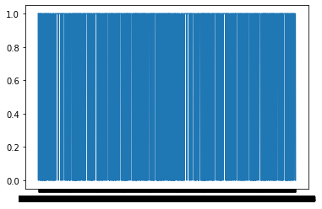
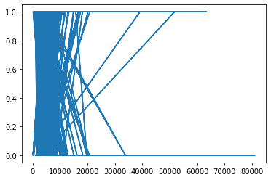
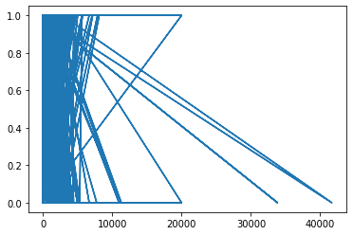
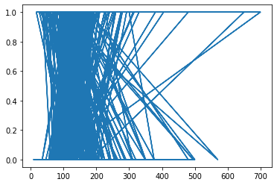
GRAPHS PLOTTED BETWWEN FEATURE AND TARGET VARIABLES:
LOANID APPLICANT INCOME
CO APPLICANT INCOME
LOANAMOUNT

Slide 18
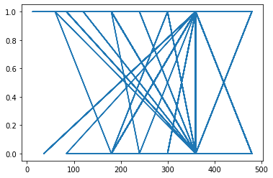
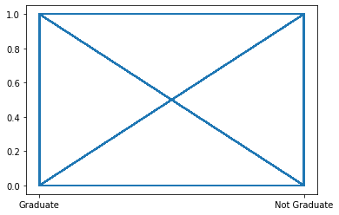
LOAN AMOUNT TEAM EDUCATION

Slide 19
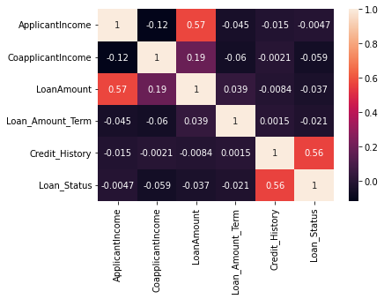
Correlation Matrix:

Slide 20
Covariance Matrix:

Slide 21
Accuracy through Logistic Regression:
Accuracy through Decision Tree:
Accuracy through KNN:
Accuracy through Navies Bayes Theorem
:
Accuracy through SVM:
Ml model | Accuracy
Support vector machine | 0.7328990228013029
Ml model | Accuracy
Decision tree | 0.8371335504885994
Ml model | Accuracy
KNN | 0.6585365853658537
Ml model | Accuracy
Navies Bayes theorem | 0.7003257328990228
Ml model | Accuracy
Logistic Regression | 0.7328990228013029

Slide 22
Conclusion
05

Slide 23

CONCLUSION
This application is working properly and meeting to all Banker requirements. This component can be easily plugged in many other systems. It works correctly and fulfills all requirements of bankers and can be connected to many other systems. There were multiple malfunctions in the computers, content errors and fixing of weight in computerized prediction systems.In the near term, the banking software could be more reliable, accurate, and dynamic in nature and can be fit in with an automated processing unit.
This project helped us to learn about the complicated system of the loan prediction system and the best model that can work with this particular project. It works correctly and fulfills all requirements of bankers. This system properly and accurately calculates the result. It predicts the loan is approve or reject to loan applicant or customer very accurately

Slide 24

THANK YOU!

